Slide 1
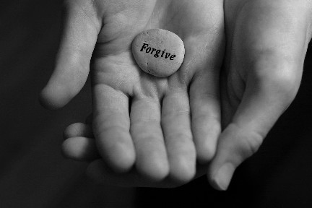
Amnesty
Many political prisoners were freed under the amnesty granted by the new regime.
(noun) a general pardon for an offense against a government; in general, any act of forgiveness or absolution

Slide 2
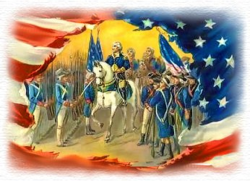
Autonomy
Even after the thirteen colonies gained autonomy from England, many Americans clung to English traditions.
(noun) self-government, political control
Synonym: home rule

Slide 3
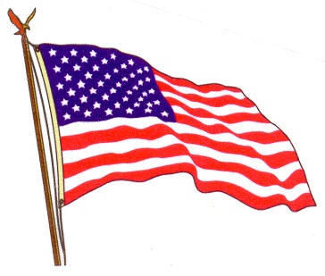
Axiomatic
One should not accept the idea that the camera never lies as an axiomatic truth.
Jefferson and our founding fathers saw life, liberty and the pursuit of happiness as axiomatic truths.
(adj.) self-evident, expressing a universally accepted principle or rule
Synonym: taken for granted

Slide 4
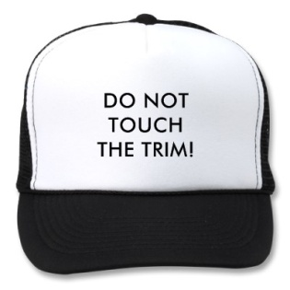
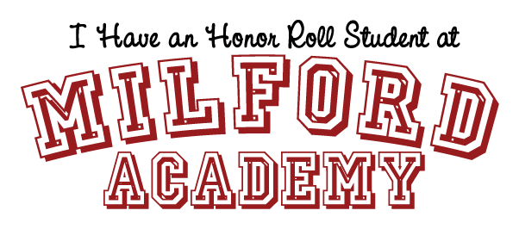
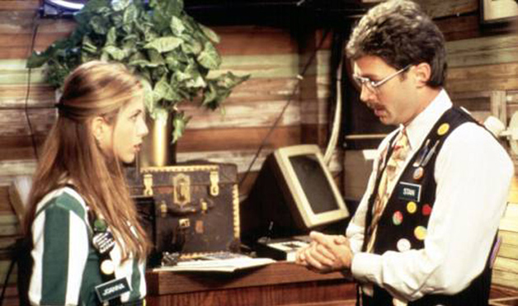
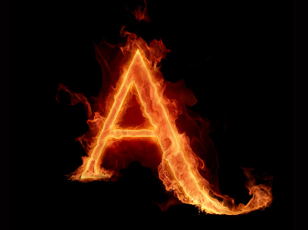
Blazon
They will blazon the results of the election across the internet and every television set in the land.
(verb) to adorn or embellish; to display conspicuously; to publish or proclaim widely
Synonym: broadcast, trumpet

Slide 5
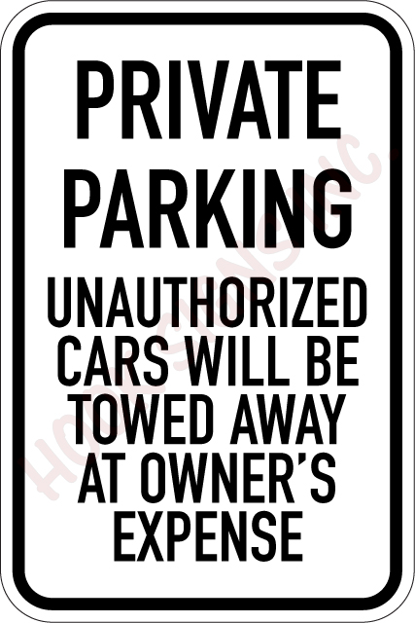
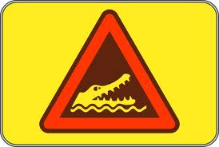
Caveat
The well known Latin phrase “caveat emptor” means buyer beware.
(noun) a warning or caution to prevent misunderstanding or discourage behavior
Synonym: admonition, word to the wise

Slide 6
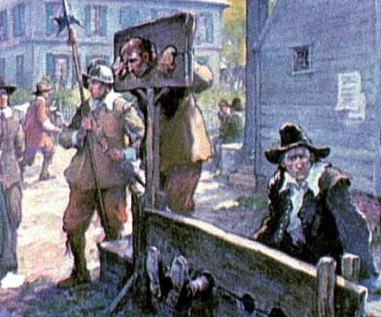
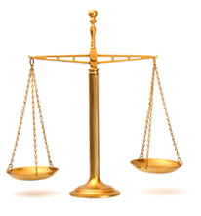
Equitable
He did more work, so a sixty-forty split of the profits seemed an equitable arrangement.
Some would say an hour in the stocks is an equitable punishment for chewing gum
(adj.) fair, just, embodying principles of justice
Synonym: right, reasonable, evenhanded

Slide 7
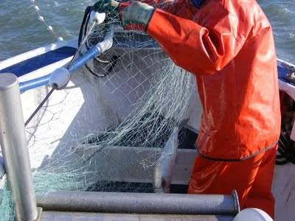
Extricate
The ring must have slid off my finger as I was trying to extricate the fish from the net.
(verb) to free from entanglements or difficulties; to remove with effort
Synonym: disentangle, extract, disengage

Slide 8
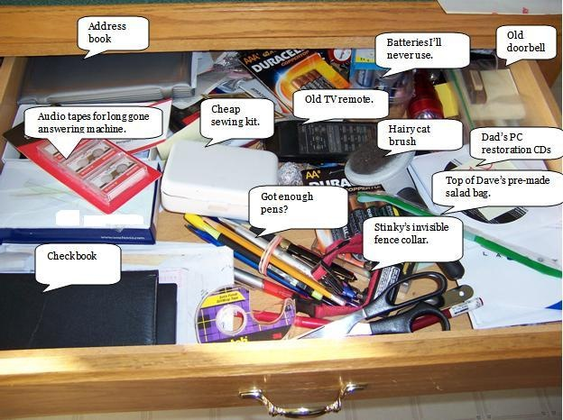
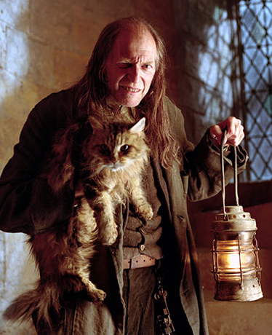
Filch
If you filch pennies from the cash drawer, you are unlikely, after a while, to be satisfied with only pennies.
(verb) to steal, especially in a sneaky way and in petty amounts
Synonym: pilfer, purloin, swipe

Slide 9
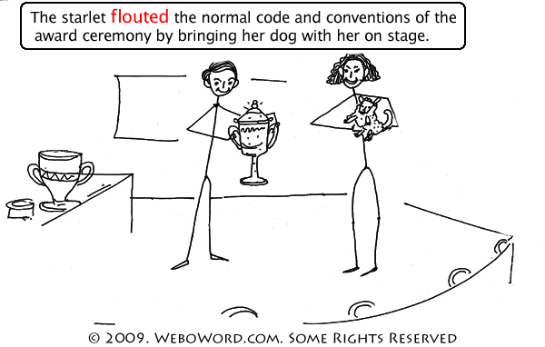
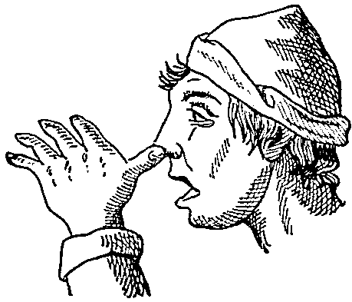
Flout
She chose to ignore my advice, not because she wanted to flout my beliefs, but because she had strong opinions of her own.
(verb) to mock, treat with contempt
Synonym: scoff at, sneer at, snicker at, scorn

Slide 10
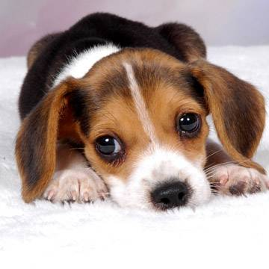
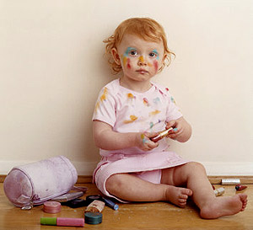
Fractious
It seems as if even the smoothest-running organizations contain one or two fractious elements.
(adj.) tending to be troublesome; unruly, quarrelsome, contrary; unpredictable
Synonym: refractory, recalcitrant, peevish
10

Slide 11
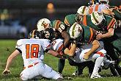
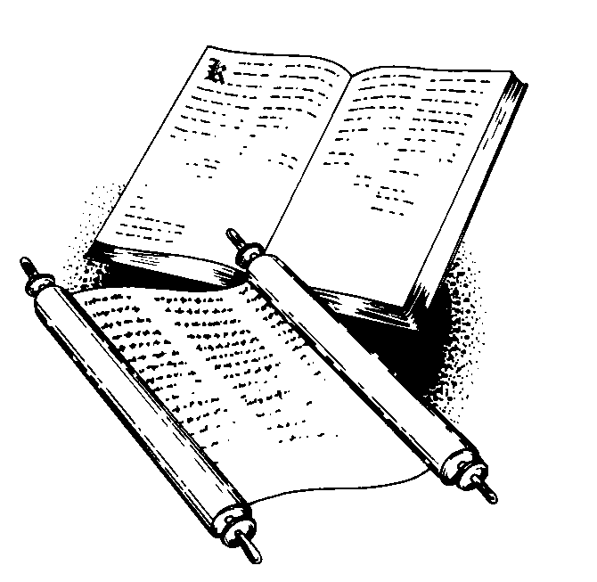
Precept
Many religions follow the precept that it is important to treat others as you, yourself, would like to be treated.
Respect
Honor
Wisdom
Courage
http://www.franklinmaxims.com/
(noun) a rule of conduct or action
Synonym: principle, maxim

Slide 12
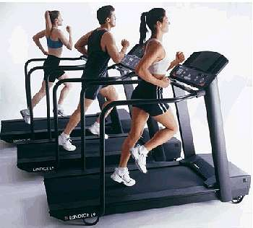
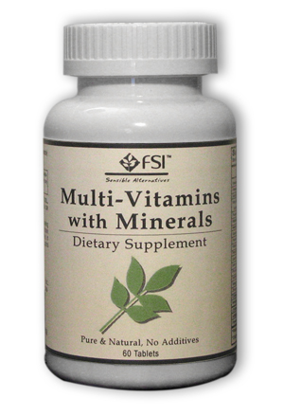
Salutary
The cute new puppy had a salutary effect on her health.
(adj.) beneficial, helpful; healthful, wholesome
Synonym: salubrious, curative

Slide 13
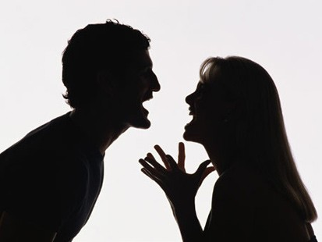
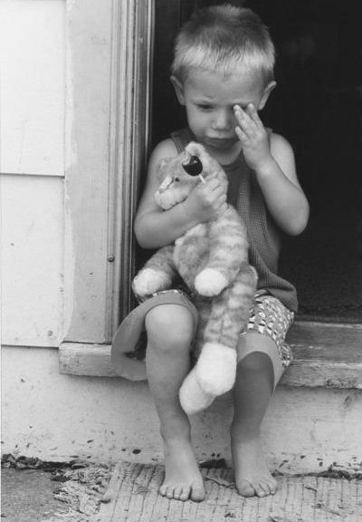
Scathing
Sometimes a carefully reasoned discussion does more to change people’s minds than a scathing attack.
(adj.) bitterly severe, withering; causing great harm
Synonym: searing, harsh, ferocious, savage

Slide 14
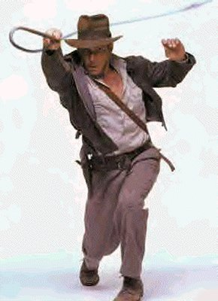
Scourge
Jonathan Swift used wit to scourge the British government for its cruel treatment of Ireland.
(verb) to whip, punish severely; (noun) a cause of affliction or suffering; a source of severe punishment or criticism
Synonym: flog, beat, bane, plague, pestilence

Slide 15
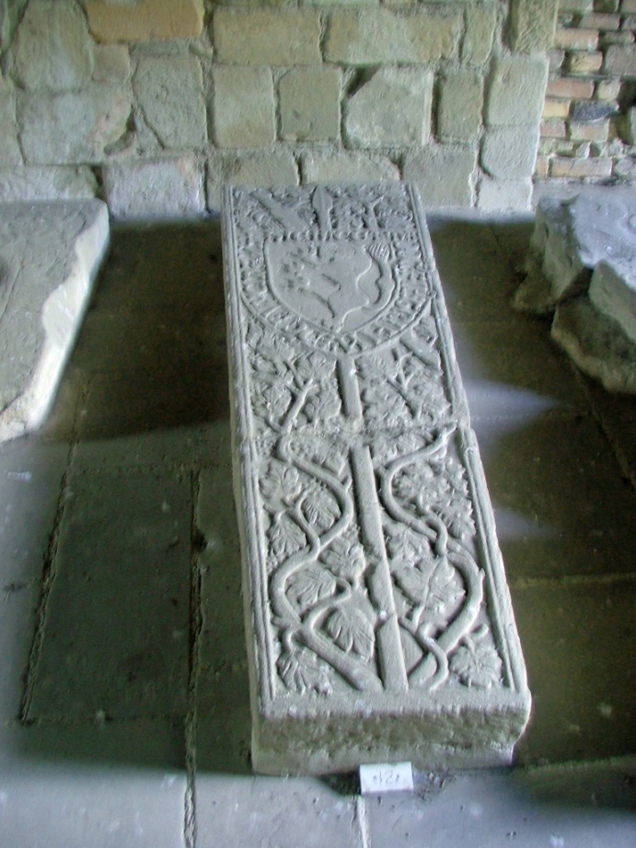
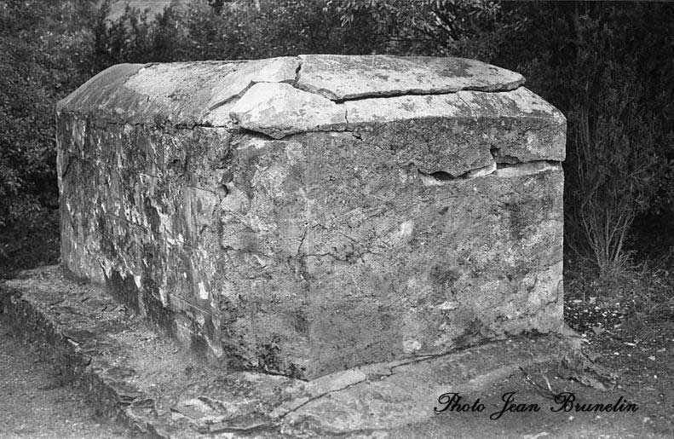
Sepulchral
My sister announced in a severe and sepulchral tone of voice that we were out of cookies.
(adj.) funereal, typical of the tomb; extremely gloomy or dismal
Synonym: doleful, lugubrious, mortuary

Slide 16
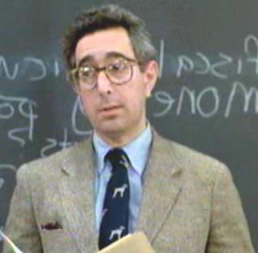
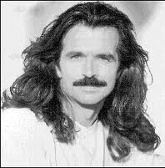
Soporific
He claimed that the musical, despite its energy, was soporific and that he had slept through the entire second act.
(adj.) tending to cause sleep, relating to sleepiness or lethargy; (noun) something that induces sleep
Synonym: narcotic, anesthetic

Slide 17
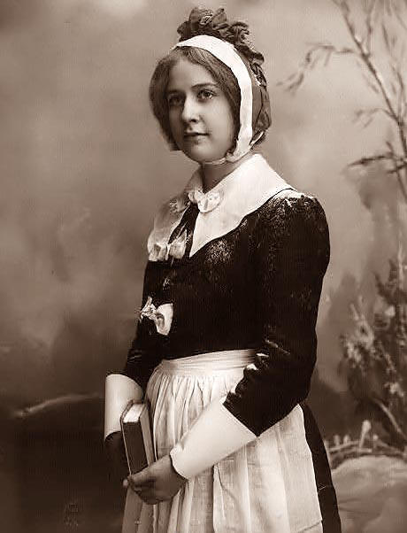
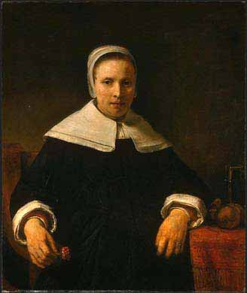
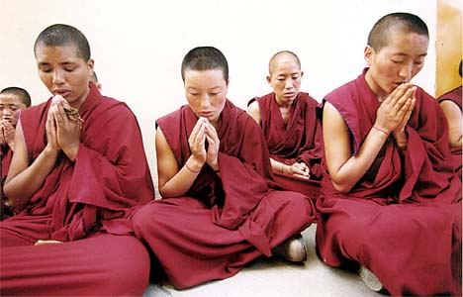
Straitlaced
The Puritans were very straitlaced in their daily living.
(adj.) extremely strict in regard to moral standards and conduct; prudish, puritanical
Synonym: highly conventional, overly strict, stuffy

Slide 18
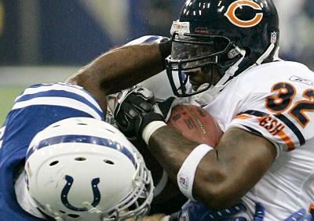
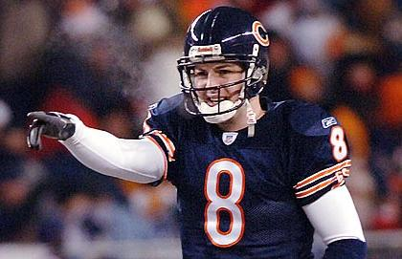
Transient
His bad mood was transient, and by the time he’d finished his breakfast, he was smiling.
Super Bowl XLI
(adj.) lasting only a short time, fleeting; (noun) one who stays only a short time
Synonym: impermanent, ephemeral, evanescent

Slide 19
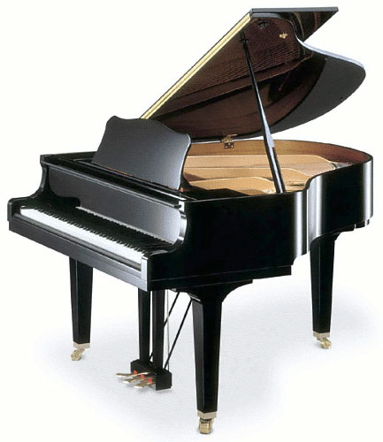
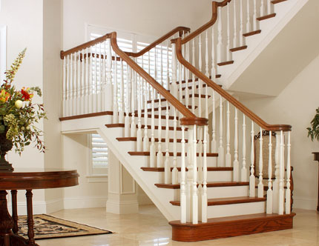
Unwieldy
We loaded the truck with the chairs and the coffee table, but the grand piano was too unwieldy.
(adj.) not easily carried, handled or managed because of size or complexity
Synonym: cumbersome, bulky, clumsy, impractical

Slide 20
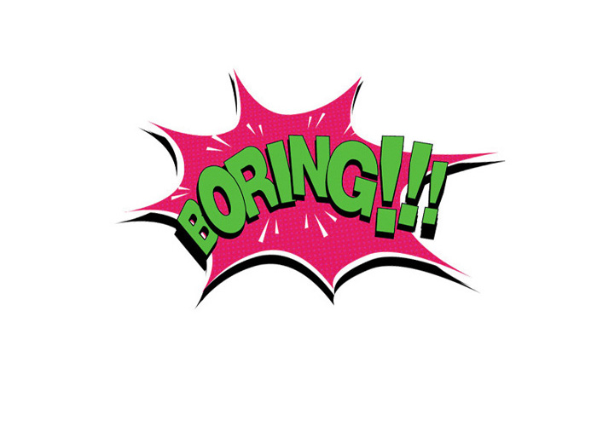
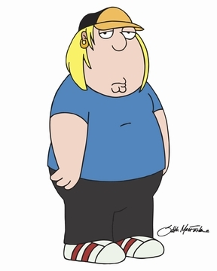
Vapid
While critics called the movie vapid, I thought the performers were very compelling.
(adj.) dull, uninteresting, tiresome; lacking in sharpness, flavor, liveliness, or force
Synonym: insipid, lifeless, colorless

